Slide 1
Midway FFA
Entomology CDE Slide Show

Slide 2
Metamorphosis
1. Complete Metamorphosis (holometabolous). Larvae and adults of these insects are very different and a distinct pupae is formed. Some insects with complete metamorphosis are: beetles, flies, bees, lacewings, butterflies, ants, and caddis flies.

Slide 3
Metamorhposis
2. Incomplete (or simple) Metamorphosis (hemimetabolous). In these insects, the nymph more or less resembles the adult and there is no pupal stage. The example shown below is a plant bug. Some other insects with incomplete metamorphosis are: crickets, true bugs, termites, grasshoppers, and cockroaches

Slide 4
Metamorphosis
3. Ametabolous insects show no metamorphosis. Here the adult looks like the immature except for the presence of genetalia and gonads. The silverfish is an example.
The exoskeleton limits the potential size of insects, but provides valuable protection to all parts of the insect including its eyes, antennae and the internal breathing tubes (tracheae). To grow and become an adult, young insects shed or molt their exoskeleton. Molting happens several times before an insect becomes an adult. A new, flexible skeleton forms beneath the old, hard exoskeleton. While taking in extra air, the insect expands itself and splits the old skin. After crawling out of the old skin, the new, soft exoskeleton starts to harden in minutes but may take several hours or days to harden completely. For some insects like a butterfly, the caterpillar is very different from the adult butterfly. In other insects like grasshoppers the young insects resemble the adults. The younger stages, called nymphs may have different color patterns and undeveloped wings and sexual organs compared with the adult. Compare the pictures above to see the difference between these two kinds of metamorphosis.

Slide 5
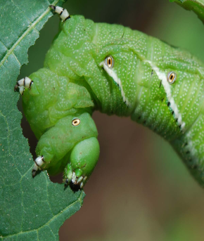
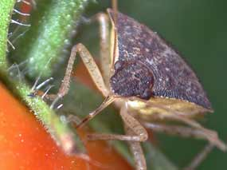
Types of Mouthparts
Chewing - feed by biting, ripping or tearing plant tissue.
Piercing/Sucking - insects have a beak, referred to as a proboscis, that is modified to suck up liquids in a manner similar to humans sucking through a straw

Slide 6
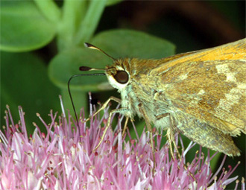
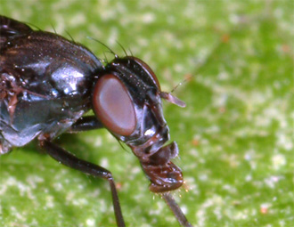
Types of Mouthparts
Siphoning - adapted to draw nectar from long-throated flowers
Sponging - appear as a conical process with spongelike lobes at the end. This type of mouth is modified to lap up liquids

Slide 7
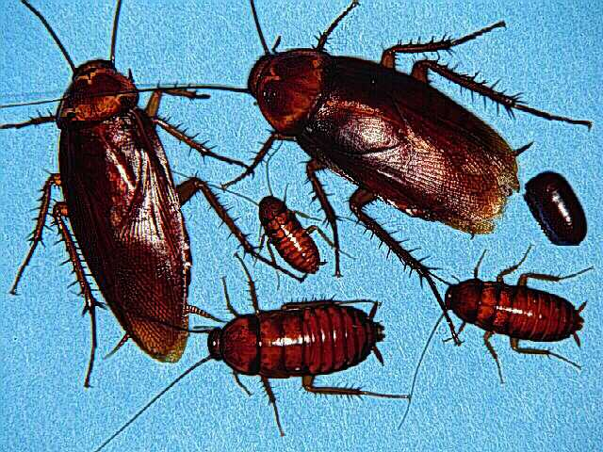
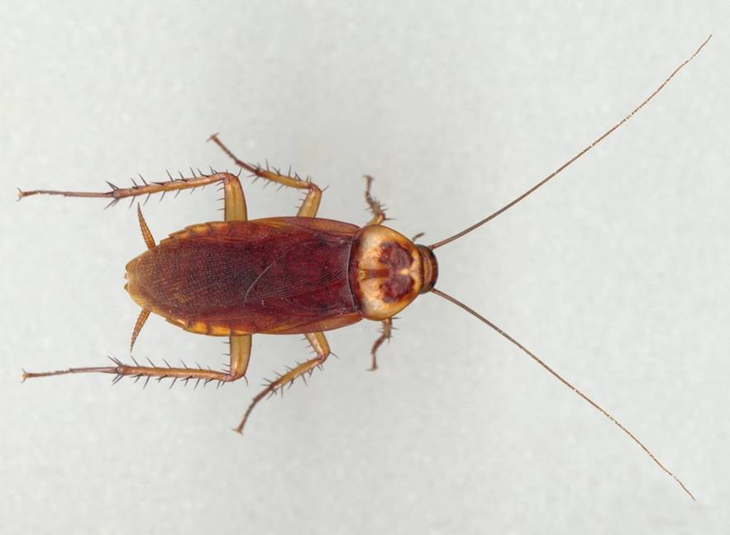
001 American cockroach
Order Blattodea
Hemi-metabolous
Chewing Mouthpart
Pest

Slide 8
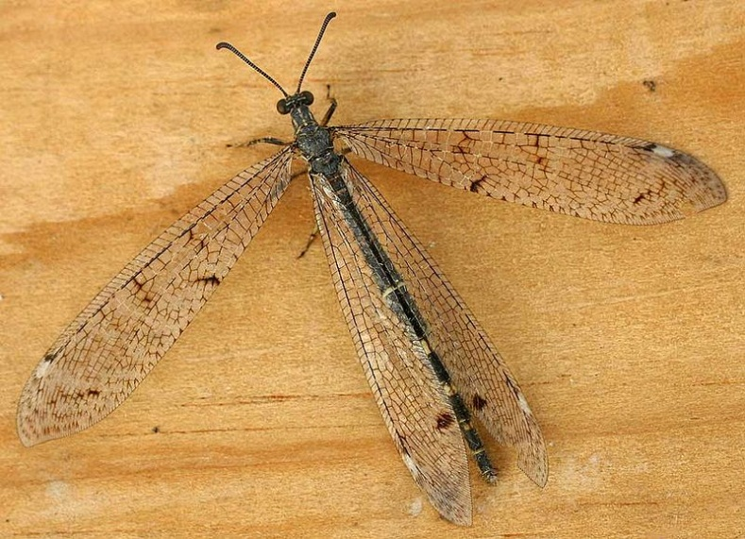
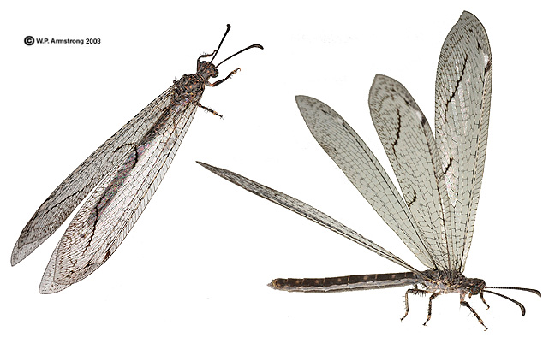
002 Antlion
Neuroptera
Holometabolous
Chewing outhpart
Beneficial

Slide 9
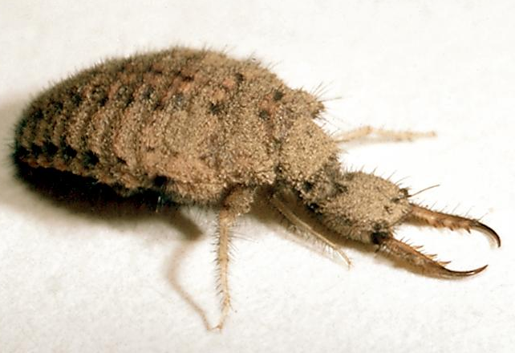
003 Antlion Larvae
Neuroptera
Holometabolous
Chewing outhpart
Beneficial

Slide 10
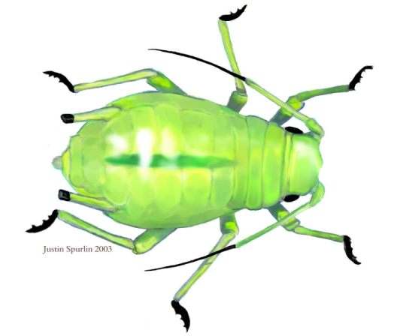
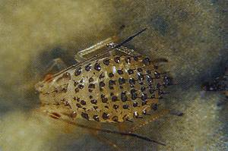
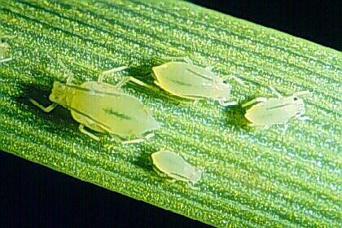
004 Aphid
Hemiptera
Hemimetabolous
Piercing-sucking
Pest

Slide 11
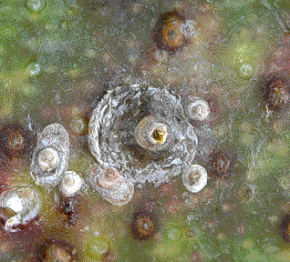
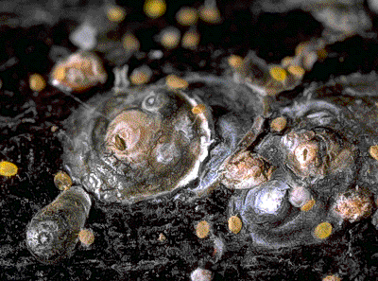
005 Armored scale
Hemiptera
Hemimetabolous
Piercing-sucking
Pest

Slide 12
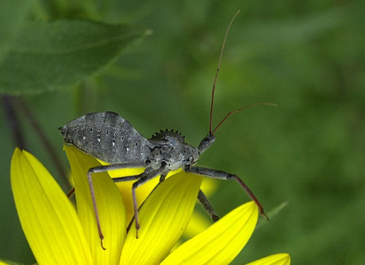
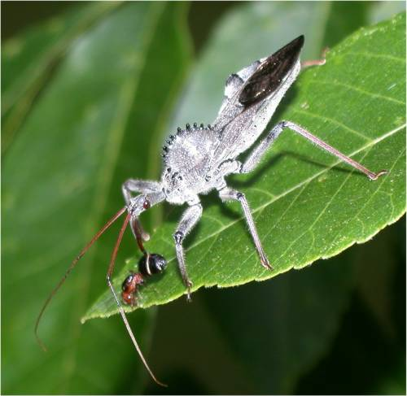
006 Assassin Bug
Hemiptera
Hemimetabolous
Piercing-sucking
Beneficial

Slide 13
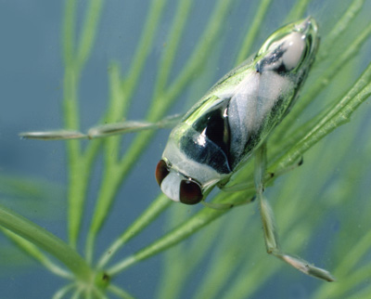
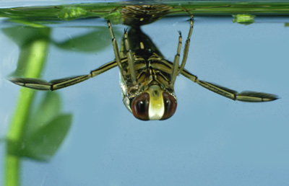
007 Backswimmer
Hemiptera
Hemimetabolous
Piercing-sucking
Beneficial

Slide 14
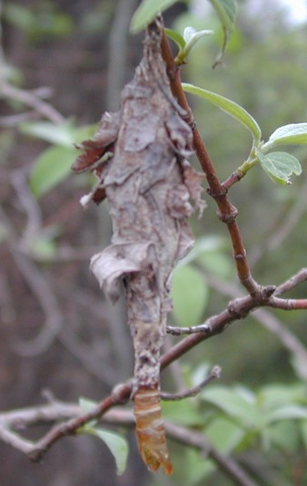
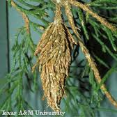
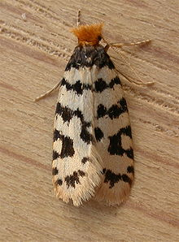
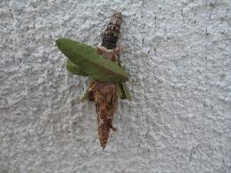
008 Bagworm
Lepidoptera
Holometabolous
Chewing
Pest

Slide 15
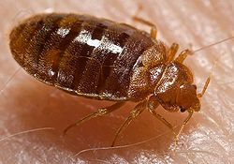
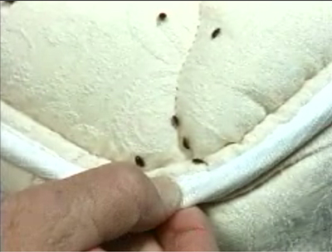
009 Bed bug
Hemiptera
Hemimetabolous
Piercing-sucking
Pest

Slide 16
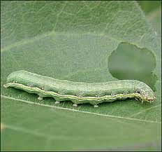
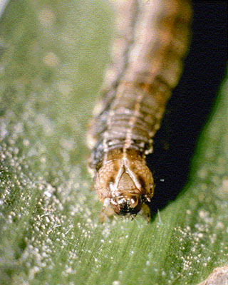
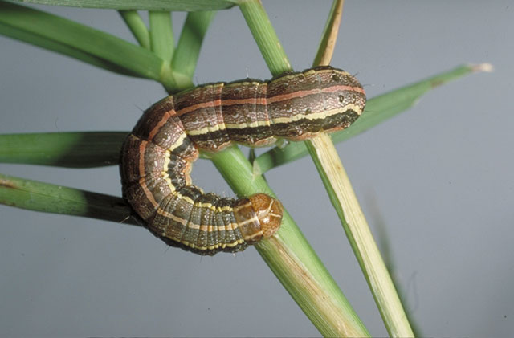
010 Beet armyworm larva
Lepidoptera
Holometabolous
Chewing
Pest

Slide 17
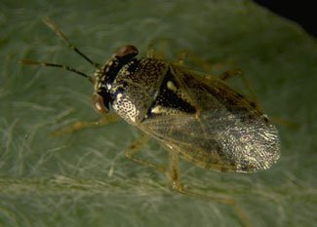
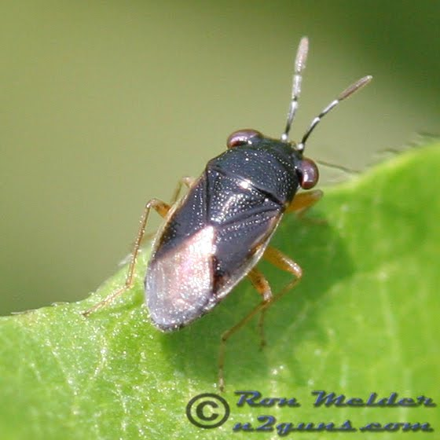
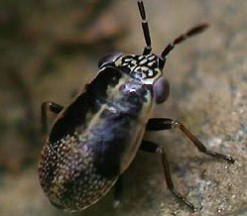
011 Big-eyed bug
Hemiptera
Hemimetabolous
Piercing-sucking
Beneficial

Slide 18
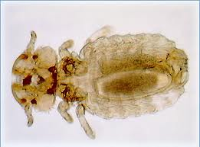
012 Biting louse
Phthiraptera
Hemimetabolous
Chewing
Pest

Slide 19
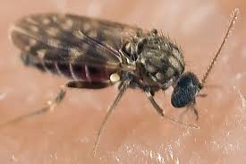
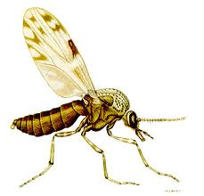
013 Biting midge
Diptera
Holometablous
Piercing-sucking
Pest

Slide 20
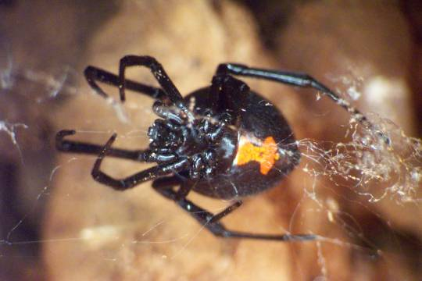
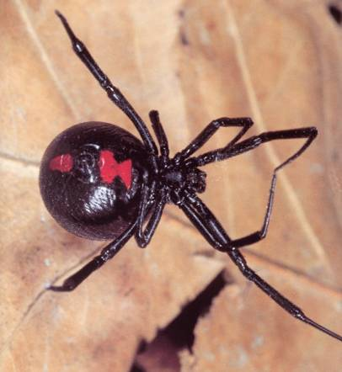
014 Black widow spider
Non-insect
Pest

Slide 21
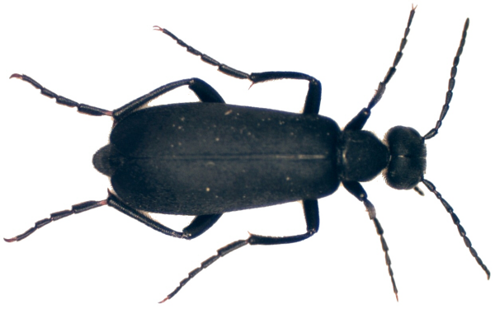
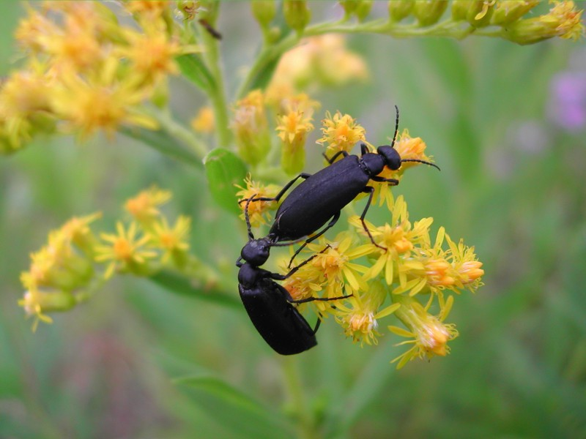
015 Blister beetle
Coleoptera
holometabolous
Chewing
Pest

Slide 22
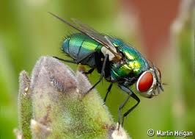
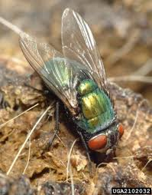
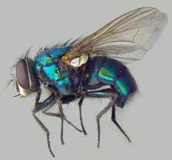
016 Blow fly
Diptera
Holometabolous
Sponging
Pest

Slide 23
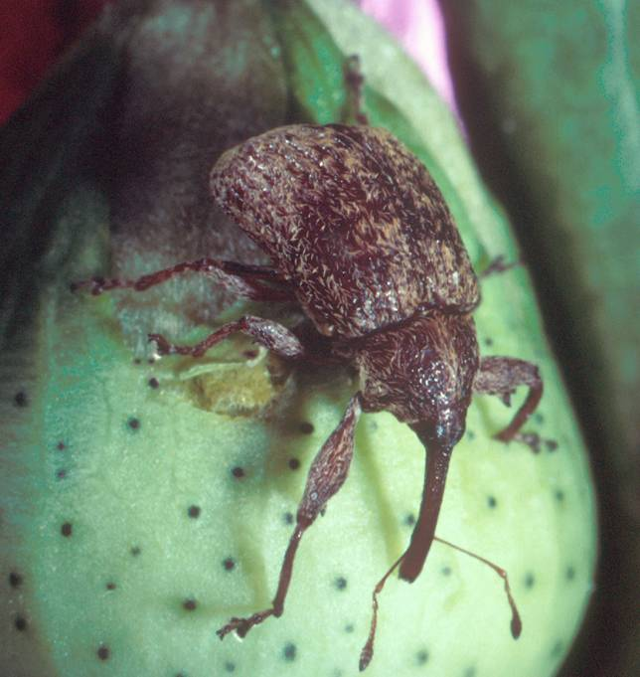
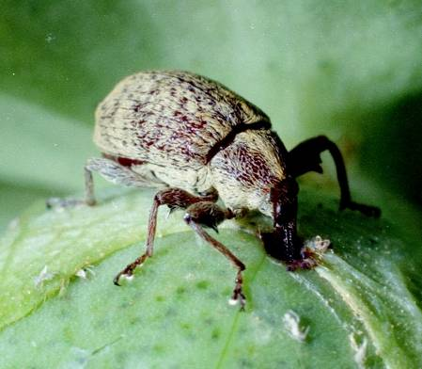
017 Boll weevil
Coleoptera
Holometabolous
Chewing
Pest

Slide 24
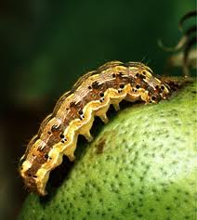
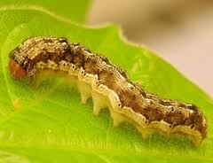
018 Bollworm
Lepidoptera
Holo-metabolous
Chewing
Pest

Slide 25
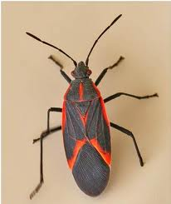
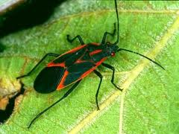
019 Boxelder bug
Hemiptera
Hemimetabolous
Piercing-sucking
Pest

Slide 26
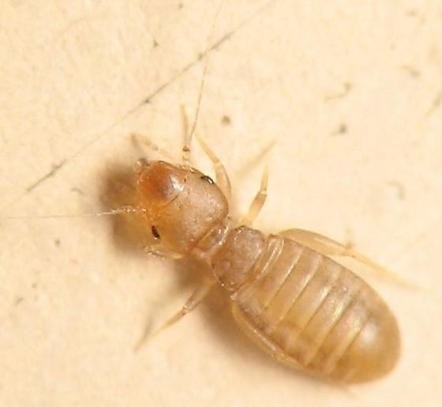
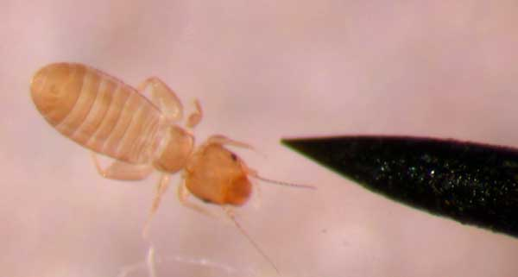
020 Book louse
Psocoptera
Ametabolus
Chewing
Pest

Slide 27
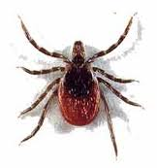
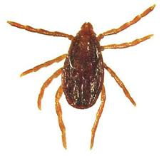
021 Brown dog tick
Non-insect
Piercing-sucking
Pest

Slide 28
022 Brown recluse spider
Non-insect
Pest

Slide 29
023 Bumble bee
Hymenoptera
Holometabolous
Chewing-lapping
Variable (Pest and Beneficial)

Slide 30
024 Cabbage looper
Lepidoptera
Holometabolous
Chewing
Pest

Slide 31
025 Carpet beetle
Coleoptera
Holometabolous
Chewing
Pest

Slide 32
026 Carrion beetle
Coleoptera
Holometabolous
Chewing
Beneficial

Slide 33
027 Cattle grub
Diptera
Holometabolous
Chewing
Pest

Slide 34
028 Centipede
Non-insect
Variable

Slide 35
029 Cicada
Hemiptera
Hemimetabolous
Piercing-sucking
Variable

Slide 36
030 Cicada Killer
Hymenoptera
Colometabolous
Chewing
Beneficial

Slide 37
031 Cigarette beetle
Coleoptera
Holometabolous
Chewing
Pest

Slide 38
032 Click beetle
Coleoptera
Holometabolous
Chewing
Variable (Beneficial and Pest)

Slide 39
033 Colorado potato beetle
Coleoptera
Holometabolous
Chewing
Pest

Slide 40
034 Crab spider
Non-insect
Beneficial

Slide 41
035 Crane fly
Diptera
Holometabolous
Piercing-sucking
Variable (Beneficial and Pest)

Slide 42
036 Damsel bug
Hemiptera
Hemimetabolous
Piercing-sucking
Beneficial

Slide 43
037 Damselfly
Odonata
Hemimetabolous
Chewing
Beneficial

Slide 44
038 Damselfly nymph
Odonata
Hemimetabolous
Chewing
Beneficial

Slide 45
039 Darkling beetle
Coleoptera
Holometabolous
Chewing
Variable (Beneficial and Pest)

Slide 46
040 Deer fly
Diptera
Holometabolous
Cutting-sponging
Pest

Slide 47
041 Deer ked
Diptera
Holometabolous
Piercing-sucking
Pest

Slide 48
041 Dobsonfly
Neuroptera
Holometabolous
Chewing
Beneficial

Slide 49
043 Dragonfly
Odonata
Hemimetabolous
Chewing
Beneficial

Slide 50
044 Dragonfly nymph
Odonata
Hemimetabolous
Chewing
Beneficial

Slide 51
045 Dung beetle
Coleoptera
Holometabolous
Chewing
Beneficial

Slide 52
046 Earwig
Dermaptera
Hemimetabolous
Chewing
Beneficial

Slide 53
047 Elm leaf beetle
Coleoptera
Holometabolous
Chewing
Pest

Slide 54
048 Fall webworm
Lepidoptera
Holometabolous
Chewing
Pest

Slide 55
049 Field cricket
Orthoptera
Hemimetabolous
Chewing
Pest

Slide 56
050 Firefly
Coleoptera
Holometabolous
Chewing
Beneficial

Slide 57
051 Flea
Siphonaptera
Holometabolous
Piercing-sucking
Pest

Slide 58
052 Flea beetle
Coleoptera
Holometabolous
Chewing
Pest

Slide 59
053 Flesh fly
Diptera
Holometabolous
Sponging
Pest

Slide 60
054 Garden spider
Non-insect
Beneficial

Slide 61
055 German cockroach
Blattodea
Hemimetabolous
Chewing
Pest
Notice Lines on Thorax

Slide 62
056 Giant water bug
Hemiptera
Hemimetabolous
Piercing-sucking
Beneficial

Slide 63
057 Banded winged grasshopper
Orthoptera
Hemimetabolous
Chewing
Pest

Slide 64
058 Gray hairstreak
Lepidoptera
Holometabolous
Siphoning
Pest

Slide 65
059 Green June beetle
Coleoptera
Holometabolous
Chewing
Pest

Slide 66
060 Green lace wing
Neuroptera
Holometabolous
Chewing
Beneficial

Slide 67
061 Ground beetle
Coleoptera
Holometabolous
Chewing
Beneficial

Slide 68
062 Harlequin bug
Hemiptera
Hemimetabolous
Piercing-sucking
Pest

Slide 69
063 Harvestman
Non-insect
Variable (Beneficial and Pest)

Slide 70
064 Hellgrammite
Neuroptera
Holometabolous
Chewing
Beneficial

Slide 71
065 Honey bee
Hymenoptera
Holometabolous
Chewing-lapping
Beneficial

Slide 72
066 Horn fly
Diptera
Holometabolous
Cutting-lapping
Pest

Slide 73
067 Horntail wasp
Hymenoptera
Holometabolous
Chewing
Pest

Slide 74
068 Horse fly
Diptera
Holometabolous
Ctting-sponging
Pest

Slide 75
069 House fly
Diptera
Holometabolous
Sponging
Pest

Slide 76
070 Ichneumon wasp
Hymenoptera
Holometabolous
Chewing
Beneficial

Slide 77
071 Indian meal moth
Lepidoptera
Holometabolous
Siphoning
Pest

Slide 78
072 Ironclad beetle
Coleoptera
Holometabolous
Chewing
Variable (Beneficial and Pest)

Slide 79
073 Jerusalem cricket
Orthoptera
Hemimetabolous
Chewing
Variable

Slide 80
074 Jumping spider
Look for the eyes
Bon-insect
Beneficial

Slide 81
075 Katydid
Orthoptera
Hemimetabolous
Chewing
Variable

Slide 82
076 Lace bug
Hemiptera
Hemimetabolous
Piercing-sucking
Pest

Slide 83
077 Lacewing larva
Neuroptera
Holometabolous
Chewing
Beneficial

Slide 84
078 Ladybird beetle
Coleoptera
Holometabolous
Chewing
Beneficial

Slide 85
079 Ladybird beetle larva
Coleoptera
Holometabolous
Chewing
Beneficial

Slide 86
080 Leaf-footed bug
Hemiptera
Hemimetabolous
Piercing-sucking
Pest

Slide 87
081 Leafhopper
Hemiptera
Hemimetabolous
Piercing-sucking
Pest

Slide 88
082 Longhorned beetle
Coleoptera
Holometabolous
Chewing
Pest

Slide 89
083 Luna moth
Lepidoptera
Holometabolous
Siphoning
Beneficial

Slide 90
084 Mantidfly
Neuroptera
Holometabolous
Chewing
Beneficial

Slide 91
085 May beetle
Coleoptera
Holometabolous
Chewing
Pest

Slide 92
086 Mayfly
Ephemeroptera
Hemimetabolous
Vestigial
beneficial
IN glass vial

Slide 93
087 Mealybug
Hemiptera
Hemimetabolous
Piercing-sucking
Pest

Slide 94
088 Metallic wood boring beetle
Coleoptera
Holometabolous
Chewing
Pest

Slide 95
089 Milkweed bug
Hemiptera
Hemimetabolous
Piercing-sucking
Pest

Slide 96
090 Millipede
Non-insect
Chewing
Beneficial

Slide 97
091 Minute pirate bug
Hemiptera
Hemimetabolous
Piercing-sucking
Beneficial

Slide 98
092 Mole cricket
Orthoptera
Hemimetabolous
Chewing
Pest

Slide 99
093 Monarch butterfly
Lepidoptera
Holometabolous
Siphoning
Beneficial

Slide 100
094 Mosquito
Diptera
Holometabolous
Piercing-sucking
Pest

Slide 101
095 Mud-dauber wasp
Hymenoptera
Holometabolous
Chewing
Variable

Slide 102
096 Oriental cockroach
Blattodea
Hemimetabolous
Chewing
Pest

Slide 103
097 Painted lady
Lepidoptera
Holometabolous
Siphoning
Beneficial

Slide 104
098 Paper wasp
Hymenoptera
Holometabolous
Chewing
Variable (Pest and Beneficial)

Slide 105
099 Pillbug
Non-insect
Chewing
Variable (Pest and Beneficial)

Slide 106
100 Praying mantis
Mantodea
Hemimetabolous
Chewing
Beneficial

Slide 107
101 Predaceous diving beetle
Coleoptera
Holometabolous
Chewing
Beneficial

Slide 108
102 Red admiral
Lepidoptera
Holometabolous
Siphoning
Beneficial

Slide 109
103 Red flour beetle
Coleoptera
Holometabolous
Chewing
Pest

Slide 110
104 Red harvester ant
Hymenoptera
Holometablous
Chewing
Pest

Slide 111
105 Red imported fire ant
Hymenoptera
Holometablous
Chewing
Pest

Slide 112
106 Rice Weevil
Coleoptera
Holometabolous
Chewing
Pest

Slide 113
107 Robber fly
Diptera
Holometabolous
Piercing-sucking
Beneficial

Slide 114
108 Rove beetle
Coleoptera
Holometabolous
Chewing
Beneficial

Slide 115
109 Sawtoothed grain beetle
Coleoptera
Holometabolous
Chewing
Pest
Note Jagged Edged Thorax

Slide 116
110 Scorpion
Non-insect
Pest

Slide 117
111 Scorpionfly
Mecoptera
Holometabolous
Chewing
Beneficial

Slide 118
112 Silverfish
Thysanura
Ametabolous
Chewing
Pest

Slide 119
113 Skipper butterfly
Lepidoptera
Holometabolous
Siphoning
Variable (Pest and Beneficial)
Notice the Large Eyes

Slide 120
114 Snakefly
Neuroptera
Holometabolous
Chewing
Beneficial

Slide 121
115 Soft scale
Hemiptera
Hemimetabolous
Piercing-sucking
Pest

Slide 122
116 Soldier beetle
Coleoptera
Holometabolous
Chewing
Beneficial
Notice Orange Thorax

Slide 123
117 Southwestern corn borer
Lepidoptera
Holometabolous
Chewing
Pest

Slide 124
118 Sphinx moth
Lepidoptera
Holometabolous
Siphoning
Variable (Beneficial and Pest)

Slide 125
119 Spider mite
Non-insect
Piercing-sucking
Pest
8 legs

Slide 126
120 Spinose ear tick
Non insect
Piercing-sucking
Pest

Slide 127
121 Spittlebug
Hemiptera
Hemimetabolous
Piercing-sucking
Pest
Adult
Larvae

Slide 128
122 Spotted cucumber beetle
Coleoptera
Holometabolous
Chewing
Pest

Slide 129
123 Springtail
Collembola
Ametabolous
Chewing
Variable (Pest and Beneficial)
Micrscopic – Notice spike out of abdomen, that is the spring

Slide 130
124 Squash bug
Hemiptera
Hemimetabolous
Piercing-sucking
Pest

Slide 131
125 Stag beetle
Coleoptera
Holometabolous
Chewing
Variable (Pest and Beneficial)

Slide 132
126 Stonefly
Plecoptera
Hemimetabolous
Chewing
Beneficial

Slide 133
127 Sucking louse
Phthiraptera
Hemimetabolous
Piercing-sucking
Pest

Slide 134
128 Sulphur butterfly
Lepidoptera
Holometabolous
Siphoning
Pest

Slide 135
129 Swallowtail butterfly
Lepidoptera
Holometabolous
Siphoning
Beneficial

Slide 136
130 Syrphid fly
Looks like a bee with only 2 wings
Diptera
Holometabolous
Sponging
Variable (Beneficial and Pest)

Slide 137
131 Tarantula hawk
Hymenoptera
Holometabolous
Chewing
Variable (Pest and Beneficial)

Slide 138
132 Tarnished plant bug
Hemiptera
Hemimetabolous
Piercing-sucking
Pest

Slide 139
133 Termite
Isoptera
Hemimetabolous
Chewing
Variable

Slide 140
134 Trichogramma wasp
Hymenoptera
Holometabolous
Chewing
Beneficial

Slide 141
135 Thrips
Thysanoptera
Hemimetabolous
Piercing-sucking
Variable
Microscopic

Slide 142
136 Tiger beetle
Coleoptera
Holometabolous
Chewing
Beneficial

Slide 143
137 Toad bug
Hemiptera
Hemimetabolous
Piercing-sucking
Beneficial

Slide 144
138 Tomato hornworm
Lepidoptera
Holometabolous
Chewing
Pest
Notice the horn – will be in glass vial

Slide 145
139 Tree cricket
Orthoptera
Hemimetablolous
Chewing
Variable

Slide 146
140 Treehopper
Hemiptera
Hemimetabolous
Piercing-sucking
Pest

Slide 147
141 Tumbling flower beetle
Coleoptera
Holometabolous
Chewing
Variable
Notice Tail

Slide 148
142 Velvet ant
Hymenoptera
Holometabolous
Chewing
Variable

Slide 149
143 Viceroy butterfly
Lepidoptera
Holometabolous
Siphoning
Beneficial
Similar to Monarch but this horizontal line is not in Monarch

Slide 150
144 Vinegaroon
Non-insect
Chewing
Variable

Slide 151
145 Walkingstick
Phasmatodea
Hemimetabolous
Chewing
Variable

Slide 152
146 Water boatman
Hemiptera
hemimetabolous
Piercing-sucking
Beneficial

Slide 153
147 Water strider
Hemiptera
Hemimetabolous
Piercing-sucking
Beneficial

Slide 154
148 Whirligig beetle
Coleoptera
Holometabolous
Chewing
Beneficial

Slide 155
149 White grub
Coleoptera
Holometabolous
Chewing
Pest

Slide 156
150 Whitefly
Hemiptera
Hemimetabolous
Piercing-sucking
Pest
IN A GLASS VIAL

